Slide 1
Big Data and NoSQL
Arcot (Raja) Rajasekar
rajasekar@unc.edu
Unit #03

Slide 2
Unit #03
NoSQL Databases
  Google Big Table
    Accumulo
  Amazon Dynamo
    Apache Cassandra
  Neo4J (Graph Database)
  MongoDB

Slide 3
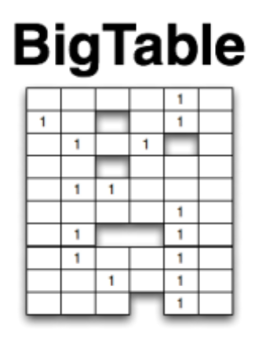
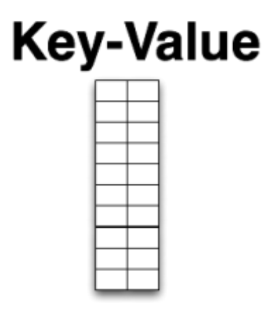
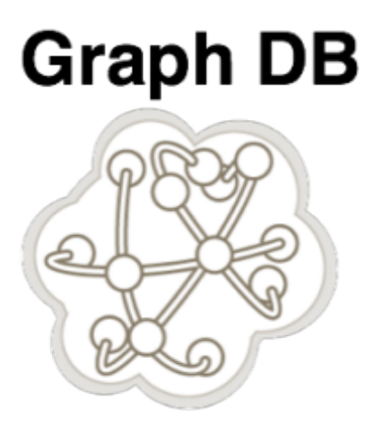
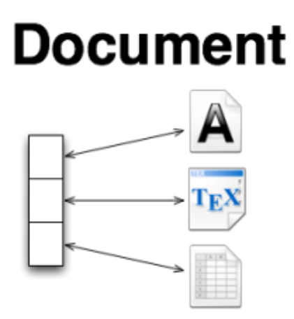
Four NOSQL Categories
Column DB
(BigTable,
Accumulo)
(Dynamo,
Cassandra)
(MongoDB)
(Neo4J)

Slide 4
Google’s
Big Table

Slide 5
Column-oriented Database
Values stored as columns instead of rows
  Store each database table column separately
  Stored contiguously, compressed, and densely packed
Hard-disk access is done by columns
  Reading a subset of a columns becomes faster
  Scattered reads/updates can be costly
Hard for row-oriented processing
  Works only for specific types of data
  Not as general purpose as RDB

Slide 6
Column-oriented Database
Efficient
  Columns compress better
    1:10 vs 1:3 (typical)
    Uniform domain values being compressed
    Value set can be small. (eg. Year)
    Compression techniques can be targeted
  Less space -> less disk access
  Column operations (replace a value)
  Sorted columns = range queries are faster
    Sparse clustering can be used to save space
  Aggregating on columns (say find sum) is faster

Slide 7
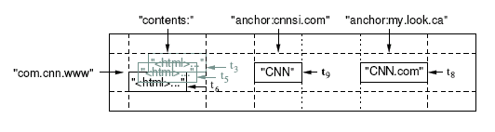
Data model: a big map
<Row, Column, Timestamp> triple for key - lookup, insert, and delete API
Arbitrary “columns” on a row-by-row basis
  Column family:qualifier. Family is heavyweight, qualifier lightweight
  Column-oriented physical store- rows are sparse!
Does not support a relational model
  No table-wide integrity constraints
  No multirow transactions
<number> of 19

Slide 8
Big Table Example
Webtable:
Row = URL (inverted url actually)
Column = various “properties” of the URL
  Content
  Pointer from other web pages
Time = when the url was fetched by Google spider
Load balanced by Rows
Access Controlled by Columns
Versioned by Timestamps

Slide 9
Columns
  Column keys are in two-parts = “family:qualifier”
  Family – similar to Object-class - printable/queriable
  Qualifier - similar to Object-instance - any string
  In RDB sense can be seen as column & values
    But treated differently
Families are used for data management
  Access control is at family level (hide a family)
  Disk and memory accounting
  Compression
    compresses better as data is of same type
The number of column families in a table is small
  100s at most
  Families rarely change during operation.
<number> of 19

Slide 10
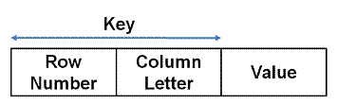
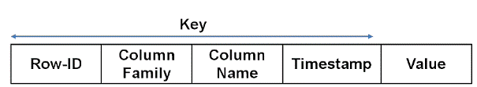
Big Table Cell Values
Relational View of a Cell:
BigTable View of a Cell:

Slide 11
Queries
By exact Key or range of Keys
Data is always returned in sorted order
Query Requirements Drive Data Model Design

Slide 12
Example
Employee Name | E Id | Dept Id | Hours Worked
Amy | 25 | 5 | 40
Andy | 30 | 10 | 30
Art | 5 | 12 | 25
Abe | 50 | 5 | 25
DeptId | Dept Name
5 | Marketing
10 | Admin
12 | Engineering
EId | Employee-Family | Department-Family
25 | Amy | Marketing | 40
30 | Andy | Admin | 30
5 | Art | Engineering | 25
50 | Abe | Marketing | 25
EId | Employee-Family | Department-Marketing | Department-Admin | Department- Engineering
25 | Amy | 40
30 | Andy |  | 30
5 | Art |  |  | 25
50 | Abe | 25

Slide 13
Big Table Building Blocks
Scheduler (Google WorkQueue)
Google Filesystem
Chubby Lock service
Map Reduce
One other pieces helpful but not required
  Sawzall
BigTable: build a more application-friendly storage service using these parts
<number> of 19

Slide 14


Server shared by many processes
Application
Server
MapReduce
Worker
Application
Server
Application
Server
Application
Server
BigTable Server
GFS Server
Cluster management System
Linux
<number> of 19

Slide 15
Tablets
Main physical storage for data
Similar to a table partition
  Contains a range of rows for a given key
  Approx. 1GB in size – can be larger when a row is very large
  A Row is not split across tablets. A tablet can contain multiple rows
A table starts as a single tablet and gets split as it grows
  Splitting done by tablet server (not Master)
Tablet server
  handles reads and writes directly from client applications
  Can handle multiple tablets (10-1000)
A table is partitioned into row ranges. Each row range is called a tablet.
A tablet is the unit of distribution and load balancing.
Clients can exploit this property to get good locality for their data accesses

Slide 16
Table
Multiple tablets make up the table
SSTables can be shared
Tablets do not overlap, SSTables can overlap
Tablet
Tablet
aardvark
apple
apple_two_E
boat
SSTable
SSTable
SSTable
SSTable
<number> of 19

Slide 17




Uses of BigTable and Kin
(BigTable)
(HBase)
Google Analytics¹
Crawl¹
AppEngine Datastore²
Many more¹
Messages^{3,4,6}
Insights^{5,6}
(Cassandra)
(Accumulo)
Rainbird (realtime analytics)⁷
1.) http://static.googleusercontent.com/external_content/untrusted_dlcp/research.google.com/en/us/archive/bigtable-osdi06.pdf
2.) http://code.google.com/appengine/articles/storage_breakdown.html
3.) http://www.facebook.com/note.php?note_id=454991608919
4.) http://mvdirona.com/jrh/TalksAndPapers/KannanMuthukkaruppan_StorageInfraBehindMessages.pdf
5.) http://www.facebook.com/note.php?note_id=10150103900258920
6.) http://borthakur.com/ftp/SIGMODRealtimeHadoopPresentation.pdf
7.) http://www.slideshare.net/kevinweil/rainbird-realtime-analytics-at-twitter-strata-2011
Notes:
20 billion events day for Insights
6+ billion msg -> 75 billion rw operations/day

Slide 18
Accumulo
Sorted, distributed key/value store
with cell-based access control
and customizable server-side processing
Modeled after BigTable/Hbase
(slides from the original Accumulo presentation)

Slide 19

Multi-dimension Key
Key
Value
Row ID
Column
Timestamp
Family
Qualifier
Visibility
http://incubator.apache.org/accumulo/user_manual_1.4-incubating/Accumulo_Design.html

Slide 20
Physical Layout
Key
Value
Row ID | Col Fam | Col Qual | Col Vis | Time | Value
Alice | properties | age | public | March 2011 | 31
Alice | properties | phone | private | Feb 2011 | 555-1234
Alice | purchases | Xbox | public | Feb 2011 | $299
Bob | properties | phone | private | March 2011 | 555-4321
Bob | purchases | iPhone | Public | Feb 2011 | $399
Notes:
Sparse,sorted

Slide 21
Hadoop MapReduce
Clients
Analytics
Read/
Write
Accumulo
Storage
Configuration/
State
Hadoop HDFS
Zookeeper

Slide 22
Access Control
Every key-value has a visibility label
Label is defined with boolean operators
Label is arbitrary and ad-hoc
Authorizations presented at scan time
Data is filtered out automatically by system-level Iterator
Public
Private | Admin
Finance | (HR & Manager)

Slide 23
Example Application: Twitter
Build an application to analyze trends in Twitter messages.
Query for word/phrase and view real-time activity in a time series graph
View at different time ranges (1 day, 7 days, 30 days, etc)
Allow multiple query terms to compare activity (ex. Breakfast,Lunch)
Automatically extract daily trends for the user
Notes:
Example: Trendistic (http://trendistic.indextank.com)

Slide 24
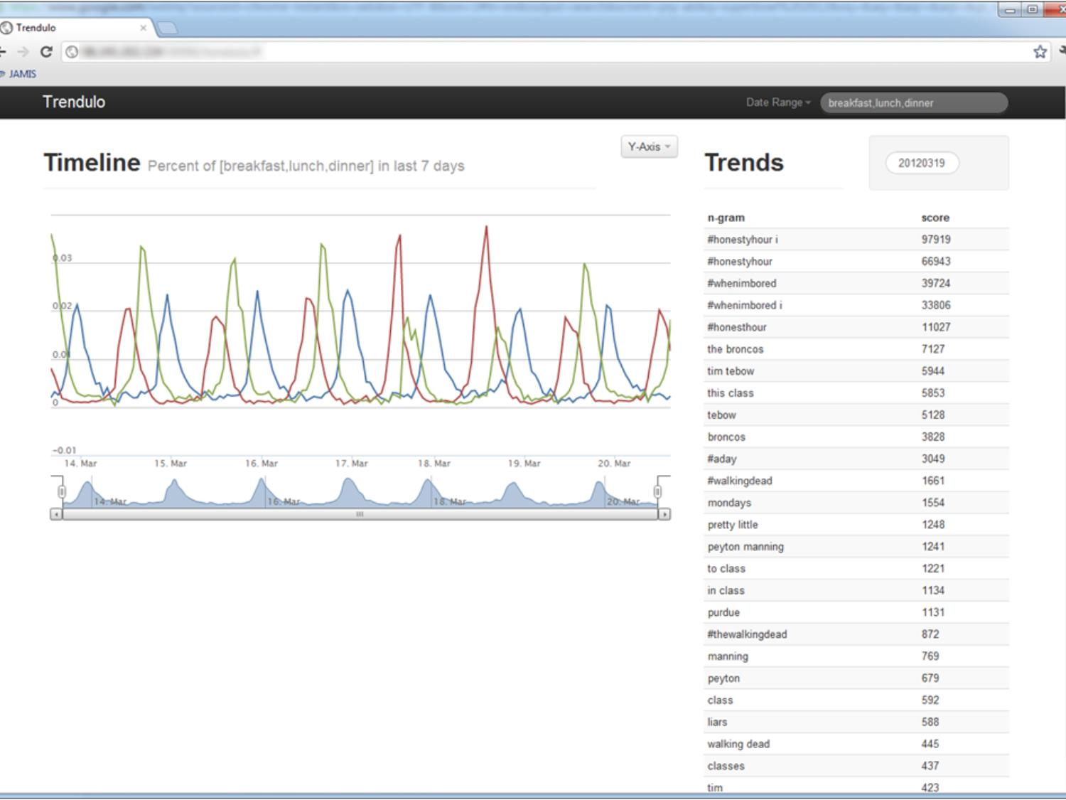

Slide 25

Data Model
Tweets table
  Row ID: n-gram
  Column Family: Date Granularity (DAY, HOUR)
  Column Qual: Date Value
  Value: Count
  SummingCombiner (Iterator) used to update Count
Row ID | Col Fam | Col Qual | Value
breakfast | DAY | 20120318 | 31
breakfast | DAY | 20120319 | 56
… | … | … | …
lunch | HOUR | 2012031801 | 3
lunch | HOUR | 2012031802 | 4

Slide 26
Data Model
Trends table
  Row ID: (Date Granularity + Date Value)
  Column Family: (Integer.MAX_VALUE – trendScore)
  Column Qual: n-gram
  Value: []
Row ID | Col Fam | Col Qual | Value
DAY:20120318 | 2147483145 | church
DAY:20120318 | 2147483316 | hangover
… | … | … | …
DAY:20120319 | 2147476521 | the broncos
DAY:20120319 | 2147477704 | tim tebow

Slide 27
Amazon’s
Dynamo

Slide 28
Read vs Write
When to catch and correct the conflict
  Traditional: When Write operations occur
    Stop two writes to the same cell by overlapping transactions (Remember: Lost Update Problem)
    In distributed replicas stop another write to any replica until current write is committed
    Writes may be rejected if conflicting
      Rollback and redo
    Writes may be rejected when a node is unavailable
      Network failure can freeze entire system
    Reads don’t have any problem. They can read (as long as it is not locked out)

Slide 29
Read vs Write
When to catch and correct the conflict
  Dynamo: When Read operations occur
    Dynamo target: “always writable”
      Don’t miss a write because of unavailability of some node or network
      Allow writes even if conflicted
      Example: shopping cart must always allow a customer to add or remove items even with failures
      Customer satisfaction is important
    Dynamo Solution: Resolve conflict at reads
      Use multiple copies to help achieve the conflict resolution
      At application level use customized conflict resolution p
      Example: Merge carts with conflicting items
      Or : At the data storage level (last write wins)
      Example: select latest price

Slide 30
Other Design Principles
Incremental Scalability
  One node added at a time
  Scale up or down, Scale as needed
  Easy to add – automatic
  Node Symmetry - Simpler system architecture
  Every node is same as its peer
  No distinguishing node that takes special responsibilities
  Easy to maintain and provision
Decentralized
  No centralized control
  No single point of failures
  Scalable - no need for grouping
Heterogeniety of system
  Any vendor any power
Fully trusted
  All applications and system nodes are trusted
  No need for ACLs, authentication, etc

Slide 31
Techniques used in Dynamo
Problem | Technique | Advantage
Partitioning | Consistent Hashing | Incremental Scalability
High Availability for writes | Vector clocks with reconciliation during reads | Version size is decoupled from update rates.
Handling temporary failures | Sloppy Quorum and hinted handoff | Provides high availability and durability guarantee when some of the replicas are not available.
Recovering from permanent failures | Anti-entropy using Merkle trees | Synchronizes divergent replicas in the background.
Membership and failure detection | Gossip-based membership protocol and failure detection. | Preserves symmetry and avoids having a centralized registry for storing membership and node liveness information.

Slide 32
Simple Interface
Remember storage is in tuples <key,blob>
Get(key) -- returns the blob or all versions of the blob
  Each blob consists of an object and its context
  Context is system metadata (including version info)
Put (key, object, context)
  Key is used to find “where” to store the object
  Multiple places (replicas)
  Uses a hash key (MD5) to map to locations
    MD5 hashing on “key” to get a 128-bit identifier
    Identifier determines “location” of where tuple is stored
  Put call can return before all replicas are written
    Remember “always writable”

Slide 33
Partitioning
And Replication
h(key1)
1
0
E
A
N=3
C
h(key2)
F
B
D
1/2

Slide 34
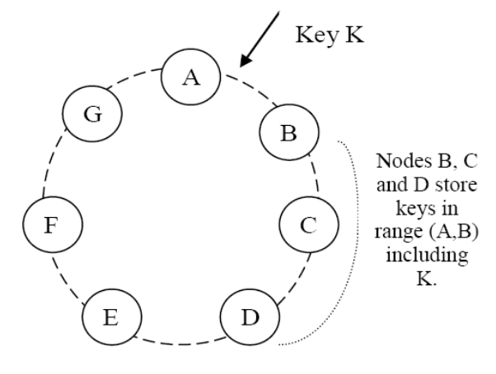
Partitioning Algorithm
Hash function is modulo
  Key hashes to a value in a ring
Each Storage node is mapped to multiple virtual nodes based on its capacity
Each virtual node is mapped to a position around the ring (randomly)
  Note that the values may not be contiguous (some numbers missing)
  A storage node may have random virtual nodes in the ring
Ring numbering is clockwise
Given Key K,
  Find the node in the ring with starting value bigger than K
  B is responsible between A & B
  B is called coordinator for K
C & D are replicas!!! (preference list)
Read requests are forwarded to coordinator nodes
Holes

Slide 35
Replication
Each data is replicated onto N nodes - multiple virtual nodes
Key K defines a coordinator node.
Coordinator is in charge of writes as well as replicating into its N-1 successors in the ring (preference list)
Each node contains data for the region of the ring between itsel and Nth predecessor
Node D has data in the range (N=2):
(A,B], (B,C] and (C, D]
from B from C and itself
Preference list is made sure to be on distinct storage nodes

Slide 36
Reconstruction/Replication
If B disappears, C and D still have the blob for K.
  Does not affect other nodes In the ring
If new key K’, comes in, it gets put in C, D and E.
  With a hint in E, that the object really belongs to B!!
  This called hinted handoff
If B reappears, it shares load from C and D.
  Gets all hinted nodes belonging to it (push from E to B)
  E may delete after successful transfer
If an entirely new node is added (say X between A and B), B,C and D will transfer appropriate key ranges to X.
at physical distinct nodes are chosen (not virtual nodes).

Slide 37
Put, Get and Versions
A Get after a Put can return a different answer
  Update propagation may be delayed because of network failures
So, each objectdata is given a “Version”
If an data is changed, a new (data,version) is created
  Older versions are immutable
  System can have multiple versions of an object
  Branchings can happen because different versions get updated
Which version is the best?
  Reconcile based on the application (client)
    Read-based consistency reconciliation
  Reconcile based on temporal hierarchy
    Vector clocks
Network failures can lead to set of versions that may have not be complete
  Delayed reconciliation

Slide 38
Versioning & Vector Clocks
Vector Clock: (node, clock) sequence
Each version of a object is associated with one vector clock.
For an object then, we have its node location and the clock counter value
Which object is the ancestor: If the counters on the first object’s clock are less-than-or-equal to all of the nodes in the second clock, then the first is an ancestor of the second and can be forgotten, otherwise reconcile

Slide 39
Writes
Put Ops
  Modify/deletion is also considered a put Op
Modify/Deletion Ops need to state the version of the object being modified
  Version is obtained when a read is performed earlier
    So, no mods/dels without prior reads
    Version is in the context provided by reads
    Version contains the vector clock information

Slide 40
Reads
On Get Op
  If there are branches with conflicting version
  Dynamo will try to reconcile to see who is the latest
  Otherwise passes all of them
  Client performs reconciliation
    And writes back a reconciled version
Problems:
  Vector clock sequence can grow very large
    Dynamo restricts the growth to 10 pairs!! - oldest is removed (uses a timestamp when the op happened)
    Arbitrary but seems to work for them

Slide 41
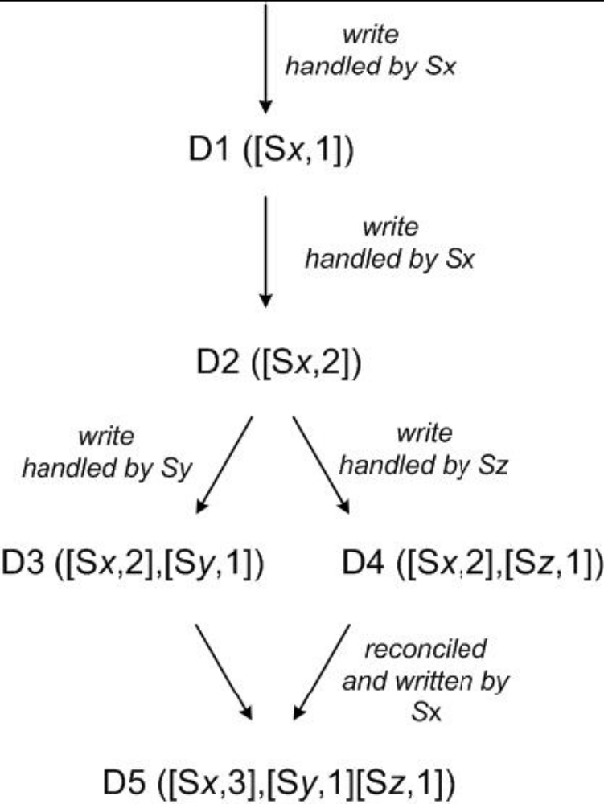
Version Evolution

Slide 42
Consistency Protocol for Reads & Writes
Normally Top N nodes (preference list, including coordinator node) participate in read and writes
  Object can have more than N copies (non-preference)
  N: Number of preference copies
  R: number of nodes to participate in a read
  W: number of nodes participate in a write
  R+W < N to get good latency - eventual consistency
  If R+W > N then reduces to quorum-based protocol
On Put - coordinator distributes copies to N-1 nodes. If W respond, it says the write is okay
On Get – coordinator asks N-1 nodes for copies. If R respond, it says the read is okay. Coordinator handles any divergence and reconciliation (or sends all to client)

Slide 43
R, W and N
Clients can tune R,W,N
R=1 high performance read
  Useful when there are only a small number of updates (possibly well controlled)
  Persistent cache – good level of scalability
W=1 highest level of availability
  Never reject a write
  Less durable, more vulnerable with inconsistency
Timestamps help in reconciliation
Common used values (N,R,W) = (3,2,2)

Slide 44
Handling Permanent Node Failures
Hinted handoff works when nodes with transient failures
Dynamo uses Replica Synchronization to handle permanent failures.
Uses Merkle Trees to compare replicas.

Slide 45
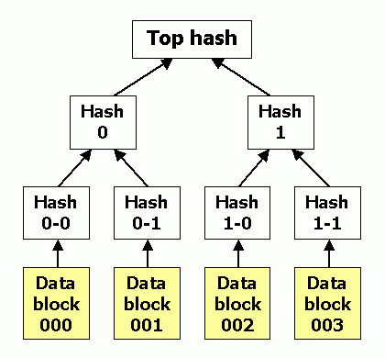
Merkle Hash Tree
  A range is formed into a tree with leaf having values and hash is computed at each level of all leaves below
  Comparing the hash at each node in the tree, one can see which part differs and can drill down to find the changes.
  No need to send whole tree or sub-tree for comparison

Slide 46
Merkle Tree Reconciliation
Each virtual node key range is used to build a Merkle Tree
Nodes which have same virtual nodes compare their trees
  First exchange the root value
  If they differ, go down level-by-level and see which branch is bad.
  Synchronize only those keys
Disadvantage: when key ranges change the tree has to be recalculated

Slide 47
Node Membership (Gossip)
Node outages are often transient
  No need to permanently rebalance in most cases
Nodes need to know who are in the ring
  Dynamo uses Gossip method
Administrator adds a node to the ring by attaching to an existing node in the ring and giving it the key-range.
Each node contacts another node (chosen at random from its list) every second and they reconcile their node membership list – lazy propogation
So, each node knows the key ranges of others and can forward calls appropriately.
They use seed nodes to make sure that there is no partitioned graphs!!!
This way nodes learn about new and failed nodes.

Slide 48
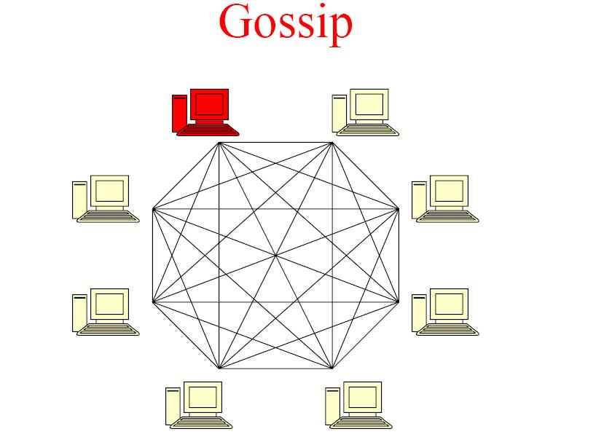

Slide 49
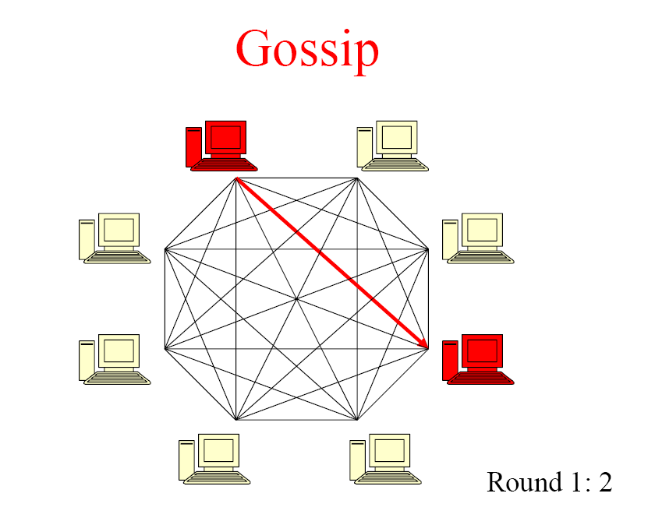

Slide 50
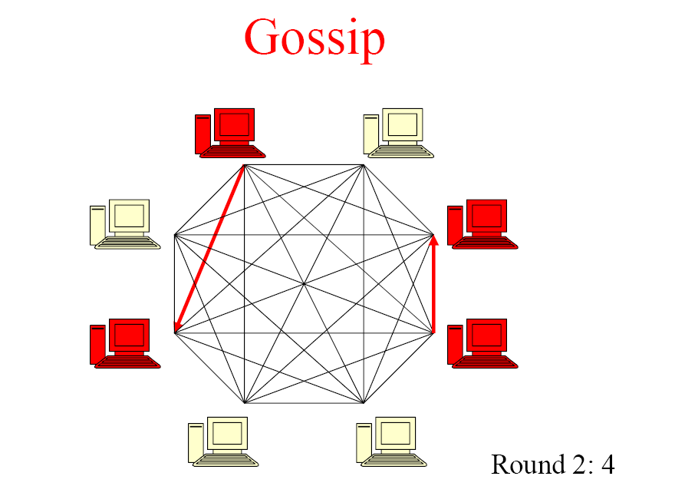

Slide 51
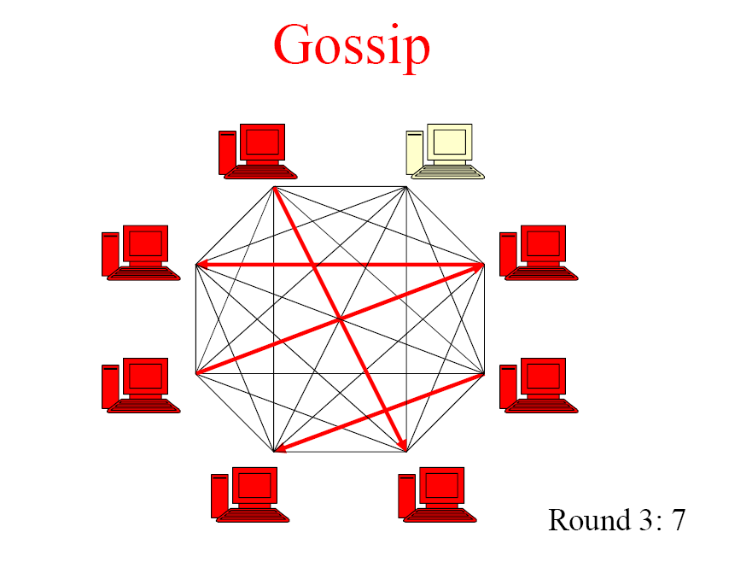

Slide 52
Cassandra
Structured Storage System over a P2P Network
Paper by Avinash Lakshman, Prashant Malik
Also read
http://www.ebaytechblog.com/2012/07/16/cassandra-data-modeling-best-practices-part-1/
http://www.ebaytechblog.com/2012/08/14/cassandra-data-modeling-best-practices-part-2/

Slide 53
Cassandra
Users:
Facebook
Twitter
Others
Based on
BigTable
Dynamo

Slide 54
Design Goals
High availability
Eventual consistency
  trade-off strong consistency in favor of high availability
Incremental scalability
Optimistic Replication
“Knobs” to tune tradeoffs between consistency, durability and latency
Low total cost of ownership
Minimal administration

Slide 55
Data Model
Table-based (as in Big Table)
Distributed
Multi-dimensional map
Indexed by key (as in Dynamo)
Dynamo treats objects as blobs
Cassandra data has structure (aspects of BigTable) but uses the hash-ring key node structure to store the rows in the table (like Dynamo)

Slide 56
Data Model
Key (typically 16-36 bytes)- can be any size
All operations on a row are atomic (BT)
Concept of Column Families (BT)
  Simple column
  Super Column – column family within a column family
Column Sorting can be
  Time (useful for Inbox search in Facebook)
  Name
Access by Column_family: Column

Slide 57
Sample Families
User_Id is key: individual user
Family 1: search by key-word
  Words in messages is super column
  Individual message_ids are simple columns (they contain that word in the super-column_name
  The simple (message) column has the body of the message and other info
Family 2: search by ‘friend’
  Sender/Recepient id’s become super-column
  Individual message_id are simple columns

Slide 58
Dynamo in Cassandra
Ring, Key, N nodes, position, etc
Coordinator, preference list, Hinted handoff, etc
load balancing, membership and failure detection, failure recovery, replica synchronization, overload handling, state transfer, concurrency and job scheduling, request marshalling, request routing, system monitoring and alarming, and configuration management
Read, Write with lazy quorum, eventual consistency
Reconciliation
Merkle tree hahs
Gossip for node management

Slide 59
BigTable in Cassandra
SSTable, MemTable
Chunks
Master-Slave servers
No deletion (marked)
Commit Log (for Writes)
Compaction
Timestamp (oldest, newest)
Replication
Indexes
Bloom Filter
Quorum

Slide 60
Cassandra Install
Cassandra web site:
http://cassandra.apache.org/
Download Page:
http://cassandra.apache.org/download/
  suggestion use DataStax if possible – easy to use
Useful links:
https://wiki.apache.org/cassandra/GettingStarted
http://www.datastax.com/2012/01/getting-started-with-apache-cassandra-on-windows-the-easy-way

Slide 61
Cassandra Query Language
CQL https://cassandra.apache.org/doc/cql/CQL.html
Examples:
SELECT Name, Occupation FROM People WHERE key IN (199, 200, 207);
SELECT FIRST 3 REVERSED 'time199'..'time100' FROM Events;
SELECT COUNT(*) FROM system.Migrations;
INSERT INTO NerdMovies (KEY, 11924) VALUES ('Serenity', 'Nathan Fillion')
USING CONSISTENCY LOCAL_QUORUM AND TTL 86400;
UPDATE NerdMovies USING CONSISTENCY ALL AND TTL 400
SET 'A 1194' = 'The Empire Strikes Back', 'B 1194' = 'Han Solo'
WHERE KEY = B70DE1D0-9908-4AE3-BE34-5573E5B09F14;
UPDATE UserActionCounts SET total = total + 2 WHERE keyalias = 523;
DELETE col1, col2, col3 FROM Planeteers
USING CONSISTENCY ONE WHERE KEY = 'Captain';
DELETE FROM MastersOfTheUniverse
WHERE KEY IN ('Man-At-Arms', 'Teela');

Slide 62
Loading Data into Cassandra
Using COPY Command
http://www.datastax.com/documentation/cql/3.0/cql/cql_reference/copy_r.html
COPY airplanes (name, manufacturer, year, mach) FROM 'temp.csv';
COPY airplanes (name, manufacturer, year, mach) TO 'temp2.csv';

Slide 63
Neo4J

Slide 64










stole
companion
from
loves
loves
appeared
in
enemy
companion
appeared
in
appeared
in
enemy
enemy
appeared
in
appeared
in
A Good Man Goes to War
Victory of
the Daleks
appeared
in

Slide 65
Social Network “path exists” Performance
Experiment:
  ~1k persons
  Average 50 friends per person
  pathExists(a,b) limited to depth 4
  Caches warm to eliminate disk IO
 | # persons | query time
Relational database | 1000 | 2000ms
Neo4j | 1000 | 2ms
Neo4j | 1000000 | 2ms

Slide 66
What’s Neo4j?
It’s is a Graph Database
Embeddable and server
Full ACID transactions
  don’t mess around with durability, ever.
Schema free, bottom-up data model design
Notes:
We are enterprise militants!
Acid always
Java first
Tens nEnterprise first
ot hundreds in a cluster
For highly connected data models – we’re not a KV store
We are GPL’d – you can use us for free if you can use MySQL for free

Slide 67
Property Graph Model
name: the Doctor
age: 907
species: Time Lord
TRAVELS_WITH
LOVES
TRAVELS_WITH
BORROWED
year: 1963
first name: Rose
late name: Tyler
TRAVELS_IN
vehicle: tardis
model: Type 40

Slide 68
More on Neo4j
Neo4j is stable
  In 24/7 operation since 2003
Neo4j is under active development
High performance graph operations
  Traverses 1,000,000+ relationships / second on commodity hardware

Slide 69
Data access is programmatic
Through the Java APIs
  JVM languages have bindings to the same APIs
    JRuby, Jython, Clojure, Scala…
Managing nodes and relationships
Indexing
Traversing
Path finding
Pattern matching

Slide 70
Core API
Deals with graphs in terms of their fundamentals:
  Nodes
    Properties
      KV Pairs
  Relationships
    Start node
    End node
    Properties
      KV Pairs

Slide 71
Creating Nodes
GraphDatabaseService db = new
EmbeddedGraphDatabase("/tmp/neo");
Transaction tx = db.beginTx();
try {
Node theDoctor = db.createNode();
theDoctor.setProperty("character", "the Doctor");
tx.success();
} finally {
tx.finish();
}
Notes:
All mutating operations on nodes, relationships (and later indexes) must be performed within a transaction.

Slide 72
Creating Relationships
Transaction tx = db.beginTx();
try {
Node theDoctor = db.createNode();
theDoctor.setProperty("character", "The Doctor");
Node susan = db.createNode();
susan.setProperty("firstname", "Susan");
susan.setProperty("lastname", "Campbell");
susan.createRelationshipTo(theDoctor,
DynamicRelationshipType.withName("COMPANION_OF"));
tx.success();
} finally {
tx.finish();
}
Notes:
Relationship types can be strings as we’re using here
Or they can be enums if you want the benefits of static typing in your IDE
Either way they’re treated the same by the DB engine – no difference in performance or richness.

Slide 73
Indexing a Graph?
Graphs are their own indexes!
But sometimes we want short-cuts to well-known nodes
Can do this in our own code
  Just keep a reference to any interesting nodes
Indexes offer more flexibility in what constitutes an “interesting node”

Slide 74
No free lunch
Indexes trade read performance for write cost
  Just like any database, even RDBMS
Don’t index every node!
(or relationship)
Notes:
Just index key nodes – the pillars or themes that underpin your domain
In Doctor Who, we index the main characters and planets, and species since these are good starting nodes for traversals.

Slide 75
MongoDB

Slide 76

Background
Creator: 10gen, former doublick
Name: short for humongous
Language: C++

Slide 77
What is MongoDB?
Defination: MongoDB is an open source, document-oriented database designed with both scalability and developer agility in mind.
Instead of storing your data in tables and rows as you would with a relational database, in MongoDB you store JSON-like documents with dynamic schemas(schema-free, schemaless).

Slide 78

What is MongoDB great for?
• RDBMS replacement for Web Applications.
• Semi-structured Content Management.
• Real-time Analytics & High-Speed Logging.
• Caching and High Scalability
Web 2.0, Media, SAAS, Gaming
HealthCare, Finance, Telecom, Government

Slide 79















In Production
http://www.mongodb.org/about/production-deployments/
Notes:
2009: Initial release
At now: version 2.2.3

Slide 80
Document store
RDBMS |  | MongoDB
Database |  | Database
Table, View |  | Collection
Row |  | Document (JSON, BSON)
Column |  | Field
Index |  | Index
Join |  | Embedded Document
Foreign Key |  | Reference
Partition |  | Shard
Notes:
Javascript

Slide 81
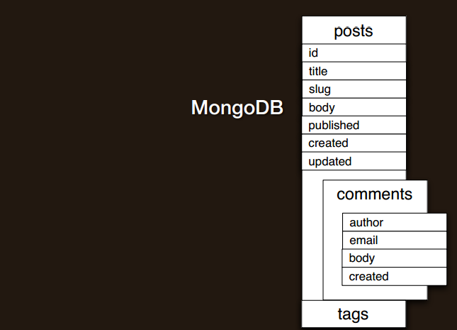
Schema design

Slide 82
Document store
RDBMS |  | MongoDB
Database |  | Database
Table, View |  | Collection
Row |  | Document (JSON, BSON)
Column |  | Field
Index |  | Index
Join |  | Embedded Document
Foreign Key |  | Reference
Partition |  | Shard
> db.user.findOne({age:39})
{
"_id" : ObjectId("5114e0bd42…"),
"first" : "John",
"last" : "Doe",
"age" : 39,
"interests" : [
"Reading",
"Mountain Biking ]
"favorites": {
"color": "Blue",
"sport": "Soccer"}
}
Notes:
Flexible schema
Javascript

Slide 83
Understanding the Document Model.
var p = {
‘_id’: ‘3432’,
‘author’: DBRef(‘User’, 2),
‘title’: ‘Introduction to MongoDB’,
‘body’: ‘MongoDB is an open sources.. ‘,
‘timestamp’: Date(’01-04-12’),
‘tags’: [‘MongoDB’, ‘NoSQL’],
‘comments’: [{‘author’: DBRef(‘User’, 4),
‘date’: Date(’02-04-12’),
‘text’: ‘Did you see.. ‘,
‘upvotes’: 7, … ]
}
> db.posts.save(p);

Slide 84
Secondary Indexes
Create Index on any field in the document
// 1 means ascending, -1 means descending
> db.posts.ensureIndex({‘author’: 1});
//Index Nested Documents
> db.posts.ensureIndex(‘comments.author’: 1);
// Index on tags
> db.posts.ensureIndex({‘tags’: 1});
// Geo-spatial Index
> db.posts.ensureIndex({‘author.location’: ‘2d’});

Slide 85
What about Queries? So Simple
// find posts which has ‘MongoDB’ tag.
> db.posts.find({tags: ‘MongoDB’});
// find posts by author’s comments.
> db.posts.find({‘comments.author’: DBRef(‘User’,2)}).count();
// find posts written after 31st March.
> db.posts.find({‘timestamp’: {‘gte’: Date(’31-03-12’)}});
// find posts written by authors around [22, 42]
> db.posts.find({‘author.location’: {‘near’:[22, 42]});
$gt, $lt, $gte, $lte, $ne, $all, $in, $nin, count, limit, skip, group, etc…

Slide 86
What about Updates? Atomic Operations makes it simple
db.posts.update({_id: ‘3432’},
{‘title’: ‘Introduction to MongoDB (updated)’,
‘text’: ‘Updated text’,
${addToSet: {‘tags’: ‘webinar’}});
$set, $unset
$push, $pull, $pop, $addToSet
$inc, $decr, many more…
Where are my joins and transactions? !!!

Slide 87
Some Cool features
• Geo-spatial Indexes for Geo-spatial queries.
$near, $within_distance, Bound queries (circle, box)
• GridFS
Stores Large Binary Files.
• Map/Reduce
GROUP BY in SQL, map/reduce in MongoDB.

Slide 88
CRUD
Create
  db.collection.insert( <document> )
  db.collection.save( <document> )
  db.collection.update( <query>, <update>, { upsert: true } )
Read
  db.collection.find( <query>, <projection> )
  db.collection.findOne( <query>, <projection> )
Update
  db.collection.update( <query>, <update>, <options> )
Delete
  db.collection.remove( <query>, <justOne> )
Notes:
Create
The field name _id is reserved for use as a primary key; its value must be unique in the collection, is immutable, and may be of any type other than an array.
The field names cannot start with the $ character.
The field names cannot contain the . character.
Create with save
If the <document> argument does not contain the _id field or contains an _id field with a value not in the collection, the save() method performs an insert of the document.
Otherwise, the save() method performs an update.
sds

Slide 89
CRUD example
> db.user.insert({
first: "John",
last : "Doe",
age: 39
})
> db.user.find ()
{
"_id" : ObjectId("51…"),
"first" : "John",
"last" : "Doe",
"age" : 39
}
> db.user.update(
{"_id" : ObjectId("51…")},
{
$set: {
age: 40,
salary: 7000}
}
)
> db.user.remove({
"first": /^J/
})

Slide 90
MongoDB Features
Document-Oriented storege
Full Index Support
Replication & High Availability
Auto-Sharding
Querying
Fast In-Place Updates
Map/Reduce
Agile
Scalable

Slide 91
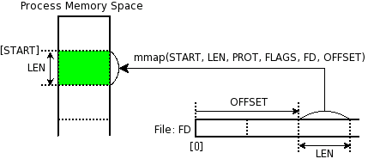
Memory Mapped Files
„A memory-mapped file is a segment of virtual memory which has been assigned a direct byte-for-byte correlation with some portion of a file or file-like resource.”¹
mmap()
¹: http://en.wikipedia.org/wiki/Memory-mapped_file
Notes:
http://docs.mongodb.org/manual/faq/storage/

Slide 92

Replica Sets
Host1:10000
Redundancy and Failover
Zero downtime for upgrades and maintaince
Master-slave replication
  Strong Consistency
  Delayed Consistency
Geospatial features
Host2:10001
Host3:10002
replica₁
Client
Notes:
DC – Data center

Slide 93
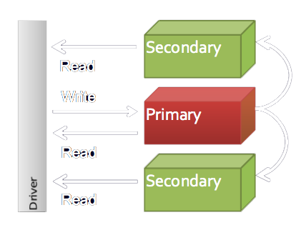
Replica Sets

Slide 94
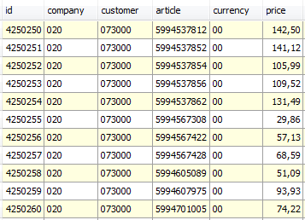
Sharding
Partition your data
Scale write throughput
Increase capacity
Auto-balancing
shard₁
shard₂
Host1:10000
Host2:10010
configdb
Host3:20000
Client
Host4:30000
Notes:
1970 – 2000: Vertical Scalability (scale-up)
Google, ~2000: Horizontal Scalability (scale-out)

Slide 95
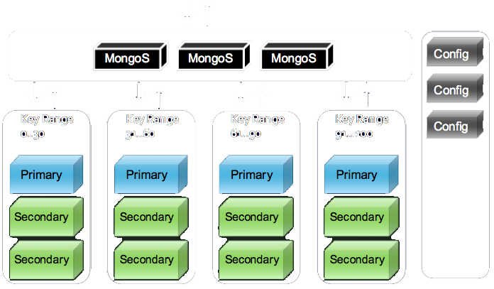
Sharding

Slide 96
Mixed
shard₁
...
Host1:10000
shard_{n}
Host2:10001
Host4:10010
Host3:10002
replica₁
configdb
Host5:20000
Client
Host6:30000
Host7:30000

Slide 97
Map reduce
Often, in a situation where you would have used GROUP BY in SQL, map/reduce is the right tool in MongoDB.
experiment

Slide 98
Install
$ wget http://downloads.mongodb.org/osx/mongodb-osx-x86_64-1.4.2.tgz
$ tar -xf mongodb-osx-x86_64-1.4.2.tgz
mkdir -p /data/db
mongodb-osx-x86_64-1.4.2/bin/mongod

